Slide 1
Module 9

Slide 2
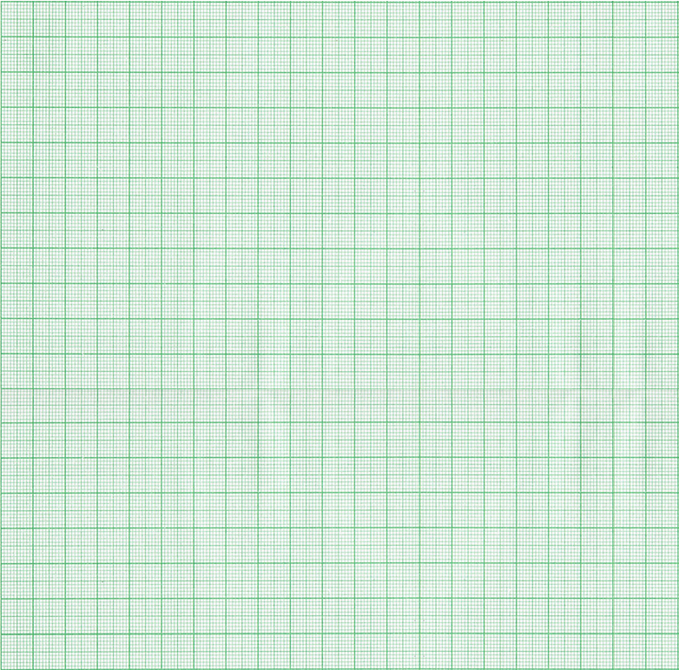
Q.
In which quadrant (s) or on which axis do each of the points
( –3 , 3 ), ( 2 , 1 ), ( 2 , 0 ), ( 0 , 4 ), ( –2 , –3 ) and ( 4 , –3 ) lie?
Verify your answer by locating them on the Cartesian plane.
( –3 , 3 )
( 2 , 1 )
( 2 , 0 )
( 0 , 4 )
Verify your answer by locating them on the Cartesian plane
Y
Scale:
On X-axis
Let A be the point
of intersection of (-3,3)
Now, let’s plot
the y co-ordinate
Lets plot the
x co-ordinate first
Soln:
(i)
In the point (–3, 3), abscissa is
negative and ordinate is positive.
So, it lies in the second quadrant.
What is the sign of
its y co-ordinate ?
4
D (0,4)
What is the sign of
Its y co-ordinate ?
Its y co-ordinate is zero
What is the sign of
its x co-ordinate ?
2 cm = 1 unit
+
-
+
What is the sign of
its x co-ordinate ?
We are supposed to
choose a suitable scale
+
Its x co-ordinate is zero
&
A (-3,3)
3
Let D be the point
of intersection of (0,4)
On Y-axis
2 cm = 1 unit
2
Let B be the point
of intersection of (2,1)
D (0,4) lies on
which axis ?
A (-3,3) lies in
which quadrant ?
Soln:
(ii)
In the point (2, 1), abscissa is
positive and ordinate is positive.
So, it lies in the first quadrant.
y-axis
IInd quadrant
1
B (2,1)
Let C be the point
of intersection of (2,0)
So, the point (-3,3)
lies in which quadrant ?
X′
IInd quadrant
X
So, the point (2,1)
lies in which quadrant ?
What do we know about any
point on the x axis ?
C (2,0)
Ist quadrant
Its y co-ordinate is zero
-4
-3
-2
-1
0
What do we know about any
point on the y axis ?
1
2
3
4
Its x co-ordinate is zero
-1
Soln:
(iii)
The point (2, 0) lies on the
x - axis.
B (2,1) lies in
which quadrant ?
Ist quadrant
-2
So, the point (2,0) lies on
which axis ?
C (2,0) lies on
which axis ?
X-axis
X-axis
So, the point (0,4) lies on
which axis ?
Soln:
(iv)
y-axis
-3
The point (0, 4) lies on the
y - axis.
-4
Y′

Slide 3
Module 10

Slide 4
Q.
In which quadrant (s) or on which axis do each of the points
( –3 , 3 ), ( 2 , 1 ), ( 2 , 0 ), ( 0 , 4 ), ( –2 , –3 ) and ( 4 , –3 ) lie?
Verify your answer by locating them on the Cartesian plane.
( –3 , 3 )
( 2 , 1 )
( 2 , 0 )
( 0 , 4 )
Verify your answer by locating them on the Cartesian plane
Y
Scale:
On X-axis
Let A be the point
of intersection of (-3,3)
Now, let’s plot
the y co-ordinate
Lets plot the
x co-ordinate first
Soln:
(i)
In the point (–3, 3), abscissa is
negative and ordinate is positive.
So, it lies in the second quadrant.
What is the sign of
its y co-ordinate ?
4
D (0,4)
What is the sign of
Its y co-ordinate ?
Its y co-ordinate is zero
What is the sign of
its x co-ordinate ?
2 cm = 1 unit
+
-
+
What is the sign of
its x co-ordinate ?
We are supposed to
choose a suitable scale
+
Its x co-ordinate is zero
&
A (-3,3)
3
Let D be the point
of intersection of (0,4)
On Y-axis
2 cm = 1 unit
2
Let B be the point
of intersection of (2,1)
D (0,4) lies on
which axis ?
A (-3,3) lies in
which quadrant ?
Soln:
(ii)
In the point (2, 1), abscissa is
positive and ordinate is positive.
So, it lies in the first quadrant.
y-axis
IInd quadrant
1
B (2,1)
Let C be the point
of intersection of (2,0)
So, the point (-3,3)
lies in which quadrant ?
X′
IInd quadrant
X
So, the point (2,1)
lies in which quadrant ?
What do we know about any
point on the x axis ?
C (2,0)
Ist quadrant
Its y co-ordinate is zero
-4
-3
-2
-1
0
What do we know about any
point on the y axis ?
1
2
3
4
Its x co-ordinate is zero
-1
Soln:
(iii)
The point (2, 0) lies on the
x - axis.
B (2,1) lies in
which quadrant ?
Ist quadrant
-2
So, the point (2,0) lies on
which axis ?
C (2,0) lies on
which axis ?
X-axis
X-axis
So, the point (0,4) lies on
which axis ?
Soln:
(iv)
y-axis
-3
The point (0, 4) lies on the
y - axis.
-4
Y′

Slide 5
( –2 , –3 ) and ( 4 , –3 )
( –2 , –3 )
( 4 , –3 )
Y
Scale:
On X-axis
Soln:
(v)
In the point (–2, –3), abscissa is
negative and ordinate is negative.
So, it lies in the third quadrant.
What is the sign of
Its y co-ordinate ?
What is the sign of
Its y co-ordinate ?
-
-
What is the sign of
Its x co-ordinate ?
What is the sign of
Its x co-ordinate ?
4
D (2,0)
+
-
2 cm = 1 unit
&
A (-3,3)
3
On Y-axis
2 cm = 1 unit
2
Soln:
(vi)
In the point (4, –3), abscissa is
positive and ordinate is negative.
So, it lies in the fourth quadrant.
1
B (2,1)
So, the point (4,-3)
lies in which quadrant ?
So, the point (-2,-3)
lies in which quadrant ?
X′
III^{rdd} quadrant
IVth quadrant
C (2,0)
X
-4
-3
-2
-1
0
1
2
3
4
Let E be the point
of intersection of (-2,-3)
-1
Let F be the point
of intersection of (4,-3)
E (-2,-3) lies in
which quadrant ?
F (4,-3) lies in
which quadrant ?
IIIrd quadrant
IVth quadrant
-2
E (-2,-3)
-3
F (4,-3)
-4
Y′

Slide 6
Module 11

Slide 7
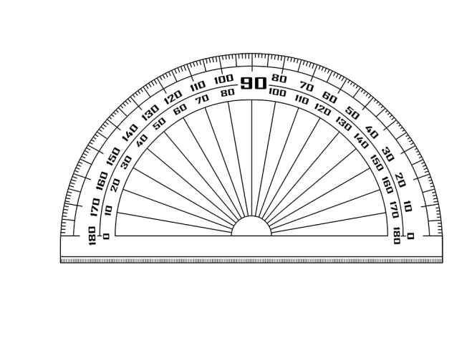
Q.
Draw the quadrilateral with vertices(-4,4), (-6,0), (-4,-4), (-2,0).
Name the type of quadrilateral.
Y
So, ABCD cannot be
a square
since in a square all
angles are 90°
,
If we observe
carefully,
∠A < 90°
Scale:
A
(
Let’s measure
angles of ABCD
-4
4
)
4
Lets plot the
x co-ordinate first
On X-axis:
Soln:
ABCD is a Rhombus
∠B > 90°
Let A be the point
of intersection of (-4,4)
Now, let’s plot
the y co-ordinate
3
2cm = 1unit
Let’s draw the
Cartesian plane
We are supposed to
choose a suitable scale
&
Let B be the point
of intersection of (-6,0)
Its y co-ordinate
is zero
Its y co-ordinate
is zero
So, the point (-2,0)
lies on which axis ?
So, the point (-6,0)
lies on which axis ?
Let’s form the
quadrilateral by joining
the points
X - axis
X - axis
2
On Y-axis:
Let D be the point
of intersection of (-2,0)
2cm = 1unit
Let’s join
AC and BD
AC and BD are the
diagonals of ABCD
1
What can we say
about AC and BD ?
,
,
AC ⊥ BD
D
(
-2
0
B
(
)
-6
0
)
X′
-6
-5
-4
-3
-2
-1
0
1
2
X
-1
Let C be the point
of intersection of (-4,-4)
-2
Which is the quadrilateral in
which diagonals are perpendicular
to each other ?
Rhombus and square
-3
C
,
(
-4
-4
)
-4
Y′

Slide 8
Module 12

Slide 9
Q.
Plot the point ( 6 , 5 ), ( 6 , -3 ), and ( -2 , -3 ).
Plot the point ( 6 , 5 ), ( 6 , -3 ), and ( -2 , -3 )
find the figure and its area.
Join them to find the figure and its area.
Join them to
Y
A
(
6
,
5
)
Let A be the point
of intersection of (6,5)
Now, let’s plot
the y co-ordinate
5
Scale:
Lets plot the
x co-ordinate first
1
On X-axis:
1
Lets draw the
Cartesian plane
Product of the
perpendicular
sides
We are supposed to
choose a suitable scale
4
2cm = 1unit
Area(Δ ABC) =
×
2
2
&
3
On Y-axis:
1
3
Let’s join the points
A, B and C
2cm = 1unit
Area(Δ ABC) =
× BC × AB
2
2
4
8
7
1
6
5
4
3
2
1
1
1
4
Product of the
perpendicular sides
Name the figure
obtained
Area(Δ ABC) =
× 8 × 8
It is a right angled
triangle
Area of a right
angled triangle ?
X′
5
X
Which are the
perpendicular
sides ?
×
2
BC and AB
-2
-1
0
1
2
3
4
5
6
2
6
-1
Let B be the point
of intersection of (6,-3)
Let C be the point
of intersection of (-2,5)
Area(Δ ABC) =
4 × 8
Measure AB
Measure BC
8
7
8
-2
8
∴
Area(Δ ABC) =
32 cm²
-3
B
(
6
,
-3
)
C
(
-2
,
-3
)
Y′

Slide 10
Module 13

Slide 11
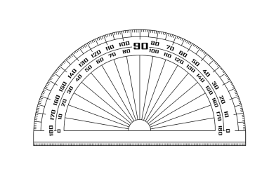
Q.
Three vertices of a square are A(-1,-9), B(3,-1), and C(-5,3)
A(-1,-9)
B(3,-1)
C(-5,3)
Plot the points
Plot the points and find the co-ordinates of the missing
vertex D.
Y
Scale:
Soln:
The co-ordinates of D are
(-9,-5).
7
Now, let’s plot
the y co-ordinate
Lets plot the
x co-ordinate first
6
On X-axis:
Let’s draw the
Cartesian plane
A quadrilateral in
which all angles
are 90°
Let C be the point
of intersection of (-5,3)
5
1cm = 1unit
We are supposed to
choose a suitable scale
let’s join AB and BC
ABCD is a square
∠ABC = 90°
4
&
What is a square ?
C
,
On Y-axis:
(
-5
3
)
3
2
1cm = 1unit
X′
1
X
-4
-3
-2
0
-9
-8
-7
-6
-5
-1
1
2
3
4
5
6
7
8
9
-1
B
,
(
3
-1
)
Let B be the point
of intersection of (3,-1)
-2
-3
-4
Now lets find the
co-ordinates of
vertex D
-5
D
-6
(
Let A be the point
of intersection of (-1,-9)
-9
,
-5
)
-7
-8
A
,
-9
(
-1
-9
)
Y′

Slide 12
Thank You

